Slide 1
JAVA BASIC
Divide and Conquer

Slide 2
Review Previous Session
Review Control Flow Statements
if/else for
swith/case while
break do/while
Create a Package com.hcl.training.helper
Create a Class OperationsHelper

Slide 3
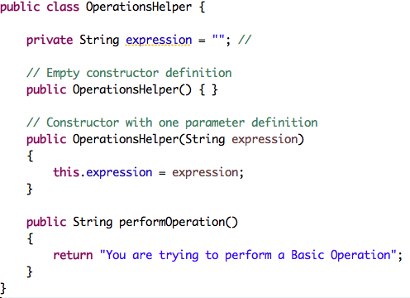
OperationsHelper
Key Concepts:
Constructors
implicit
explicit
Difference between methods and constructors
Overloading

Slide 4
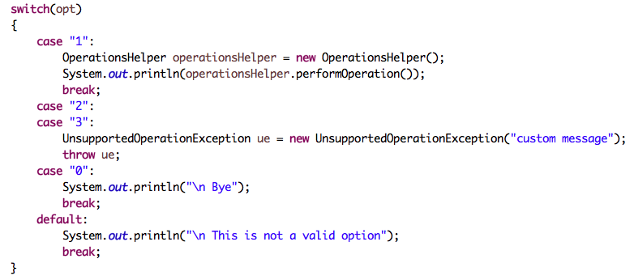
CalculatorMain
Quick Review
class
object
instace

Slide 5
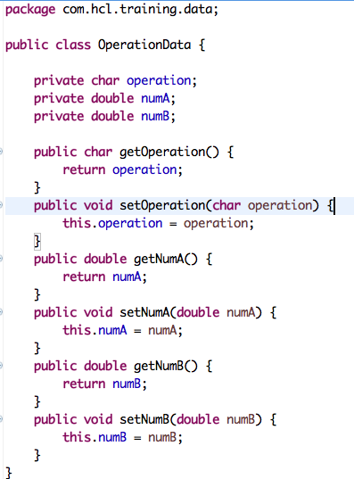
Key Concepts:
Abstraction
Encapsulation
Naming Convention
this keyword

Slide 6
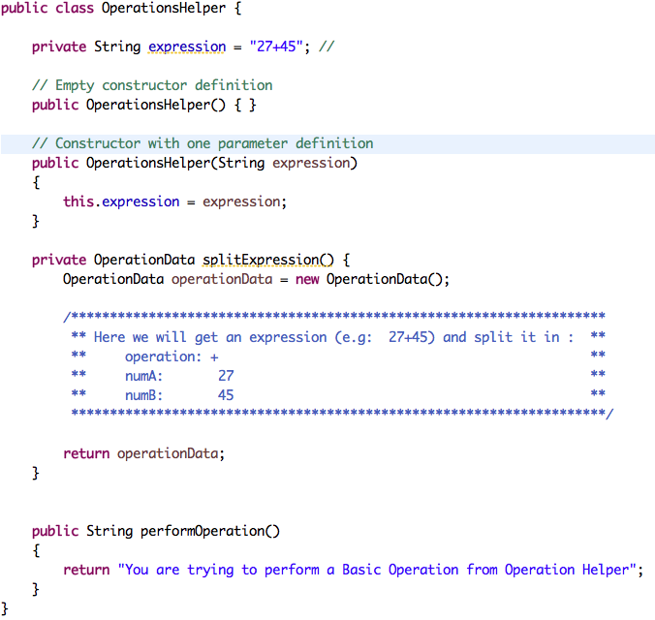
Quick Review:
methods
parameters
return value
divide and conquer

Slide 7
¿Preguntas?

